Slide 1
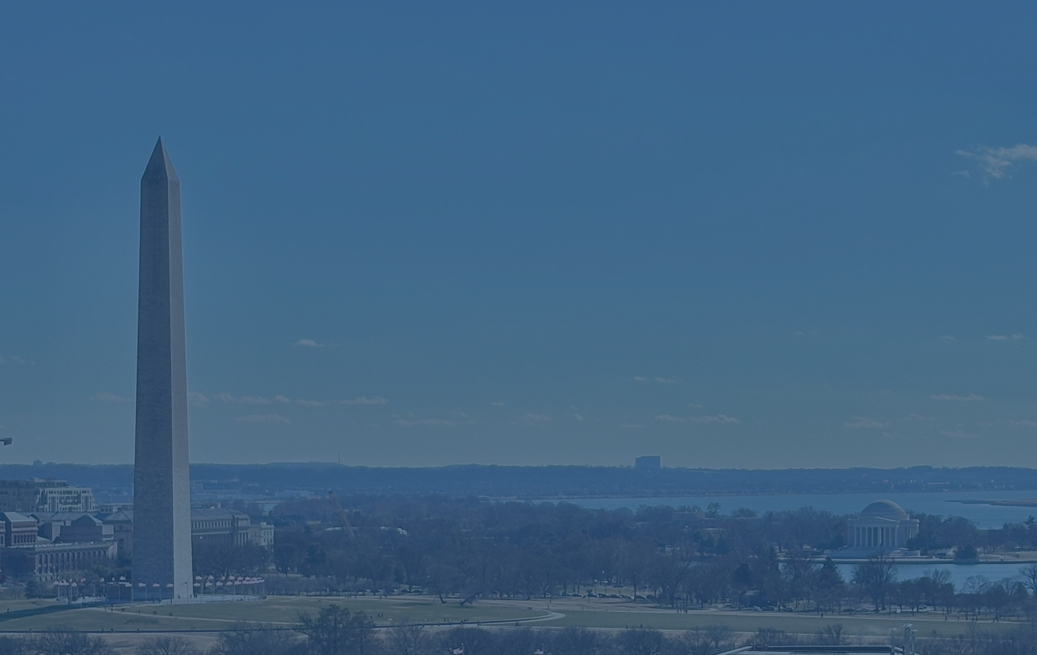

EDUCATION PROGRAM
FINAL PARTICIPANT
MEETING
STUDENTS ON TOUR

Slide 2
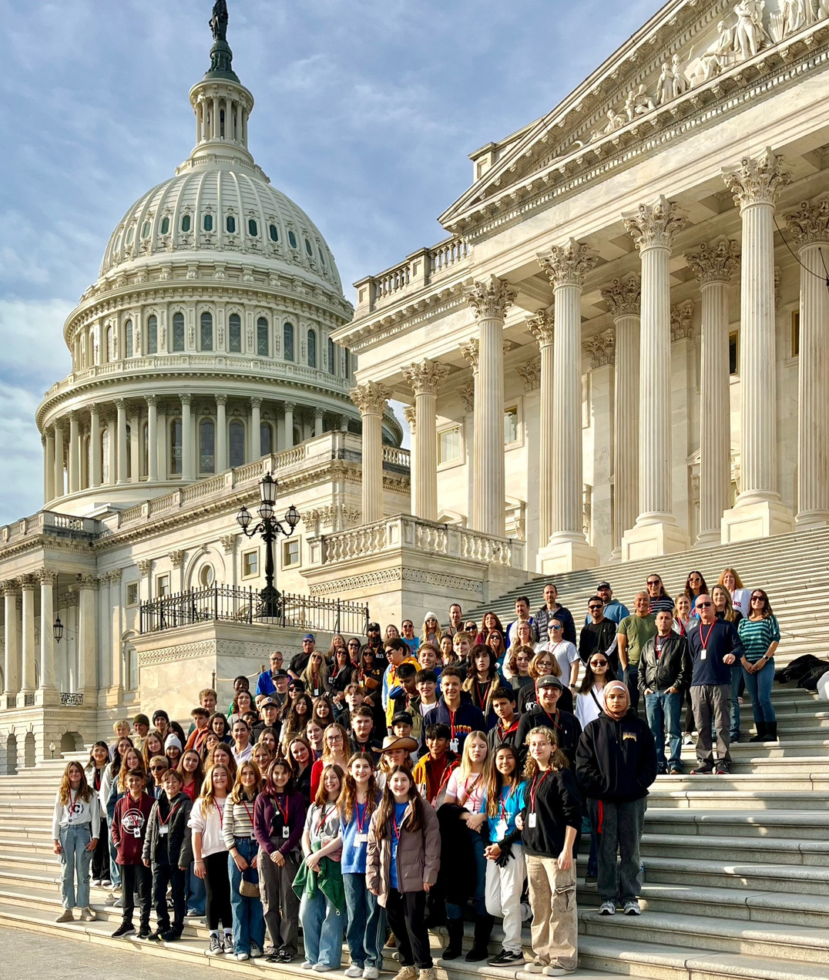
WELCOME
TRAVELERS!
We're excited to prepare for this upcoming educational travel experience together.
NOT JUST A TRIP.
A DEFINING MOMENT.

Slide 3
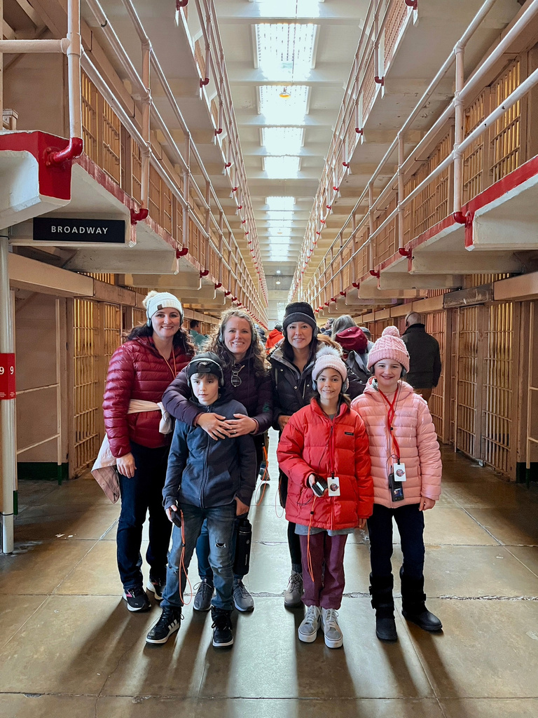
WHAT WE’LL COVER
  Final Itinerary Overview
  Departure & Arrival Logistics
  Packing & Luggage Guidelines
  Travel Expectations
    Airport
    Motorcoach
    Hotel
  Spending Money & Souvenirs
  Safety & Medical Needs
  Communication

Slide 4

FINAL ITINERARY
01
  Trip Overview
  Exact timing may adjust on the road in real time based on live events
We will always do the utmost to
maximize your travel experience!

Slide 5
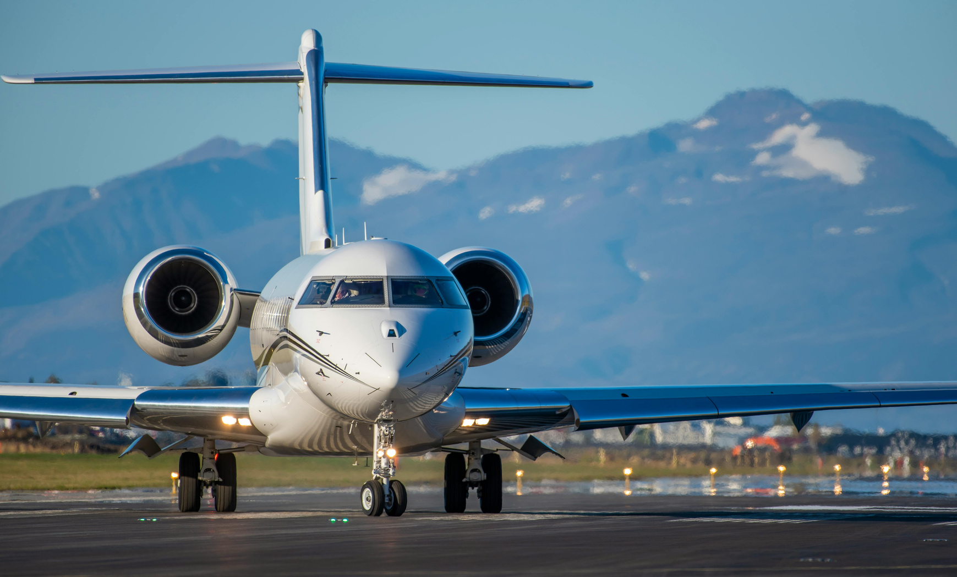
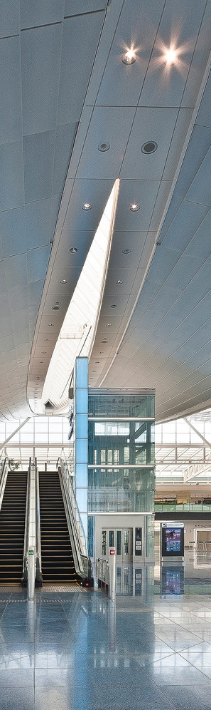
DEPARTURE + RETURN INFO
02
DEPARTURE
  Meeting location
  Time
RETURN
  Expected arrival
If delays occur, updates will be communicated to families at home.

Slide 6
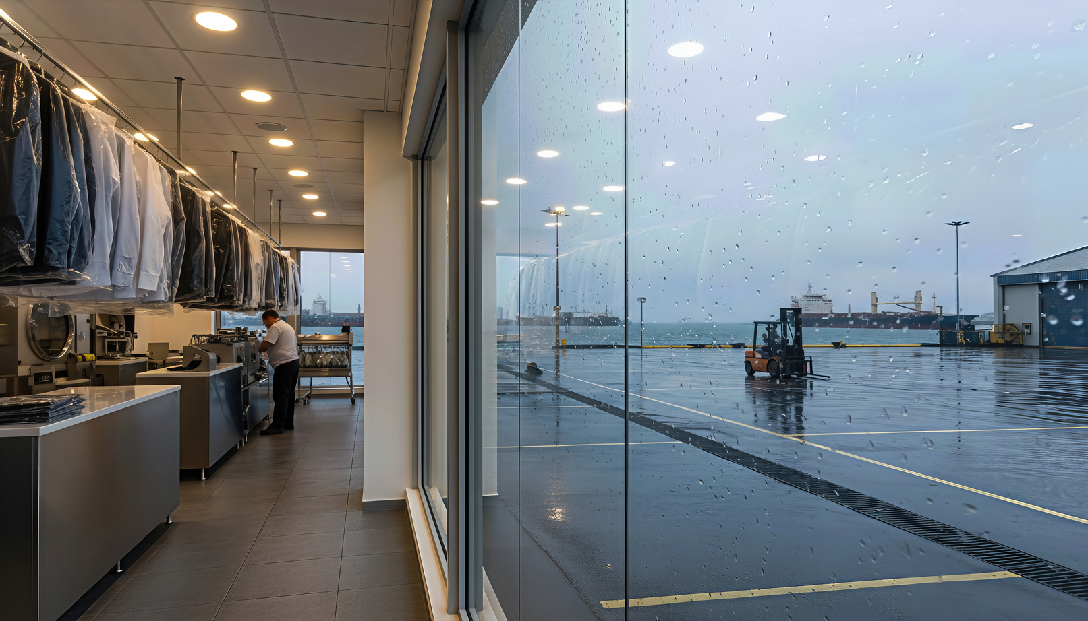
AIRPORT EXPECTATIONS
03
CHECK-IN PROCESS
  Arrive 2 hours before departure
  Standard TSA Regulations apply
  Adults (over 18) must bring government-issued REAL ID-compliant license
AIRPORT CONDUCT
  Follow all security instructions
  Be respectful on flights
  Remain seated when required

Slide 7
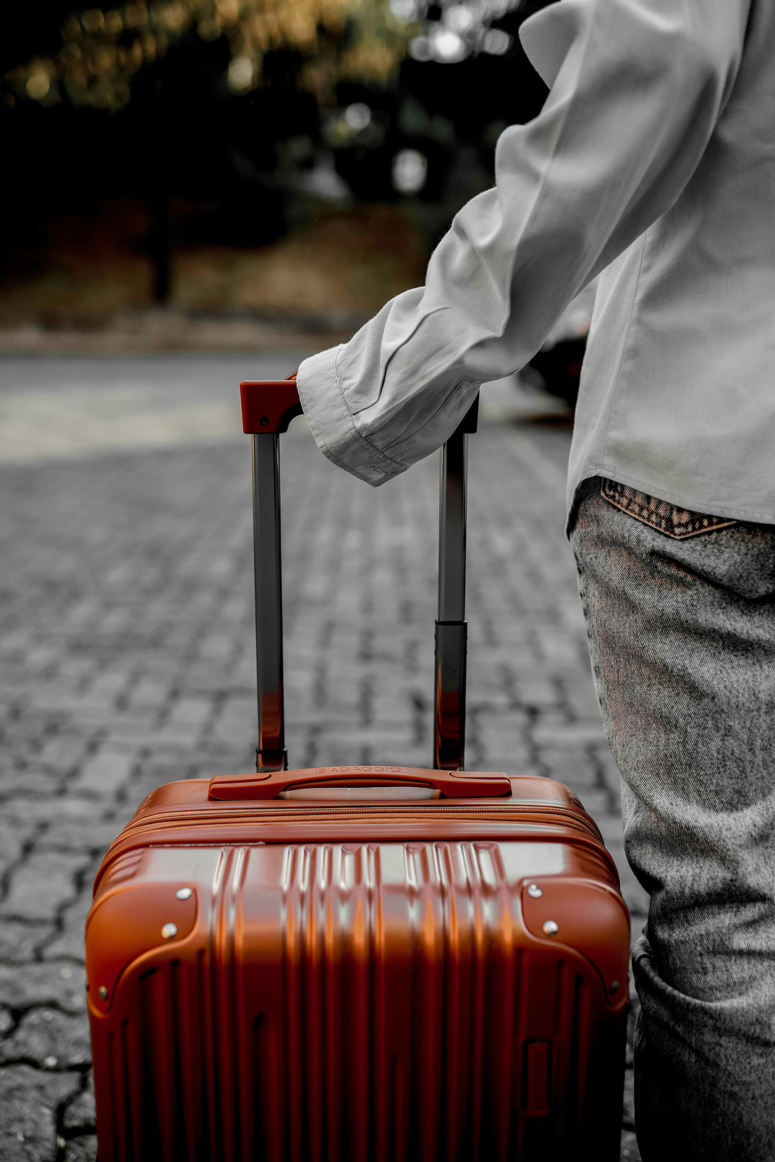
LUGGAGE
  1 suitcase (50 lbs. or less)
  1 carry-on bag or backpack
  Likely to be a checked bag fee
    Airports are cashless, so prepare for the bag fee with a card or digital payment.
Liquids in carry-ons must be 3 oz containers in a quart-size bag.

Slide 8
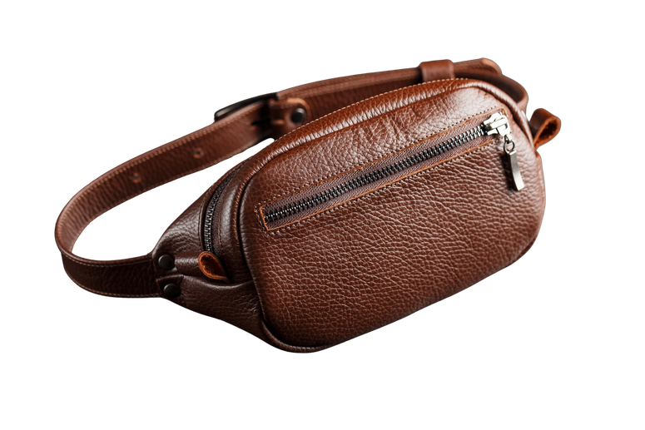
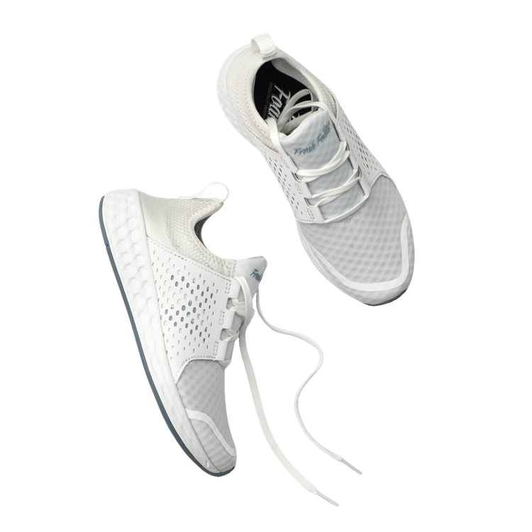




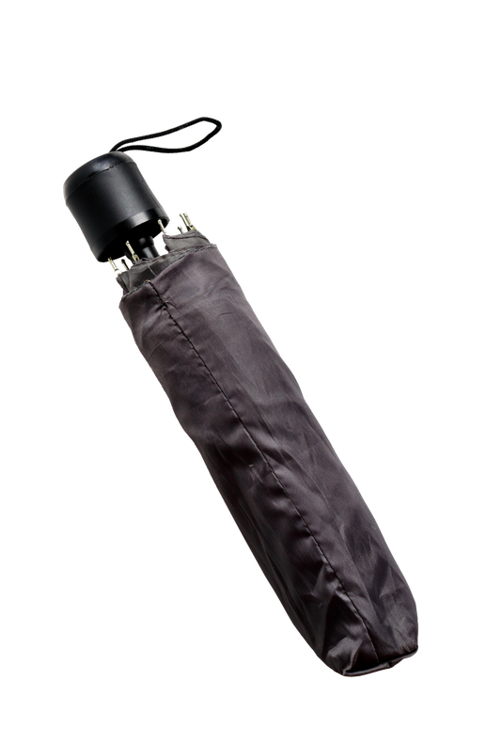
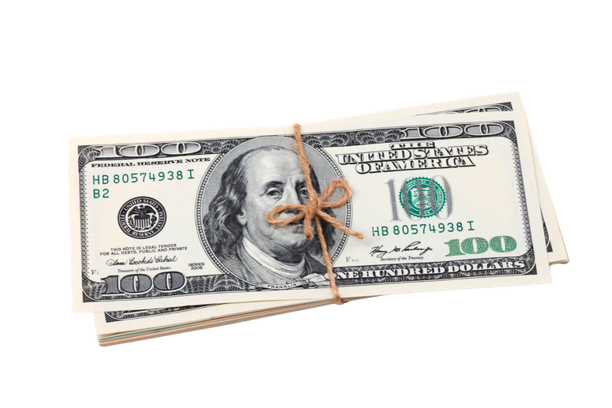
walking shoes
day bag
WHAT TO PACK
camera
flexible
layers
  Comfortable walking shoes
  Weather layers
  Rain gear
    poncho or umbrella
  Sun protection
  Small bag for daily touring
a reliable time-piece
umbrella
(and / or poncho)
souvenir money
Expect a lot of walking each day!
Prepare for weather to flucuate daily.
sunglasses

Slide 9

FLIGHT GROUPS
  Flight groups organized by motorcoach color groups
  Luggage tags provided according to flight team color
Students should always remain with their assigned group and chaperone.

Slide 10
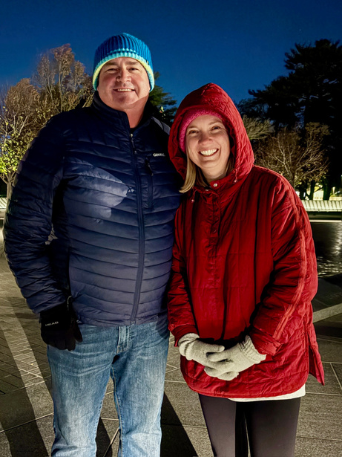
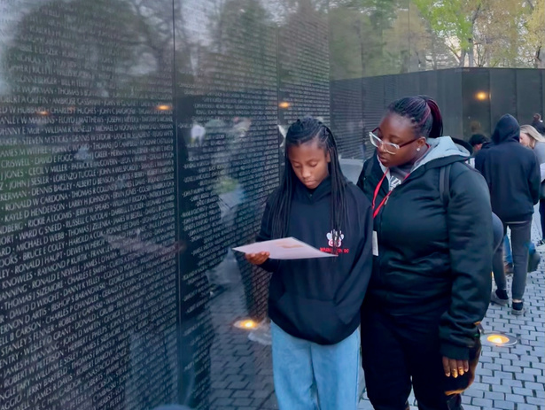
04
CHAPERONES
CHAPERONE GROUPS
  Introduction of chaperones
  Student groups assigned to each chaperone
  Contact information will be shared
CHAPERONES HELP WITH:
  Student supervision
  Head counts
  Room checks
  Communication during the trip

Slide 11
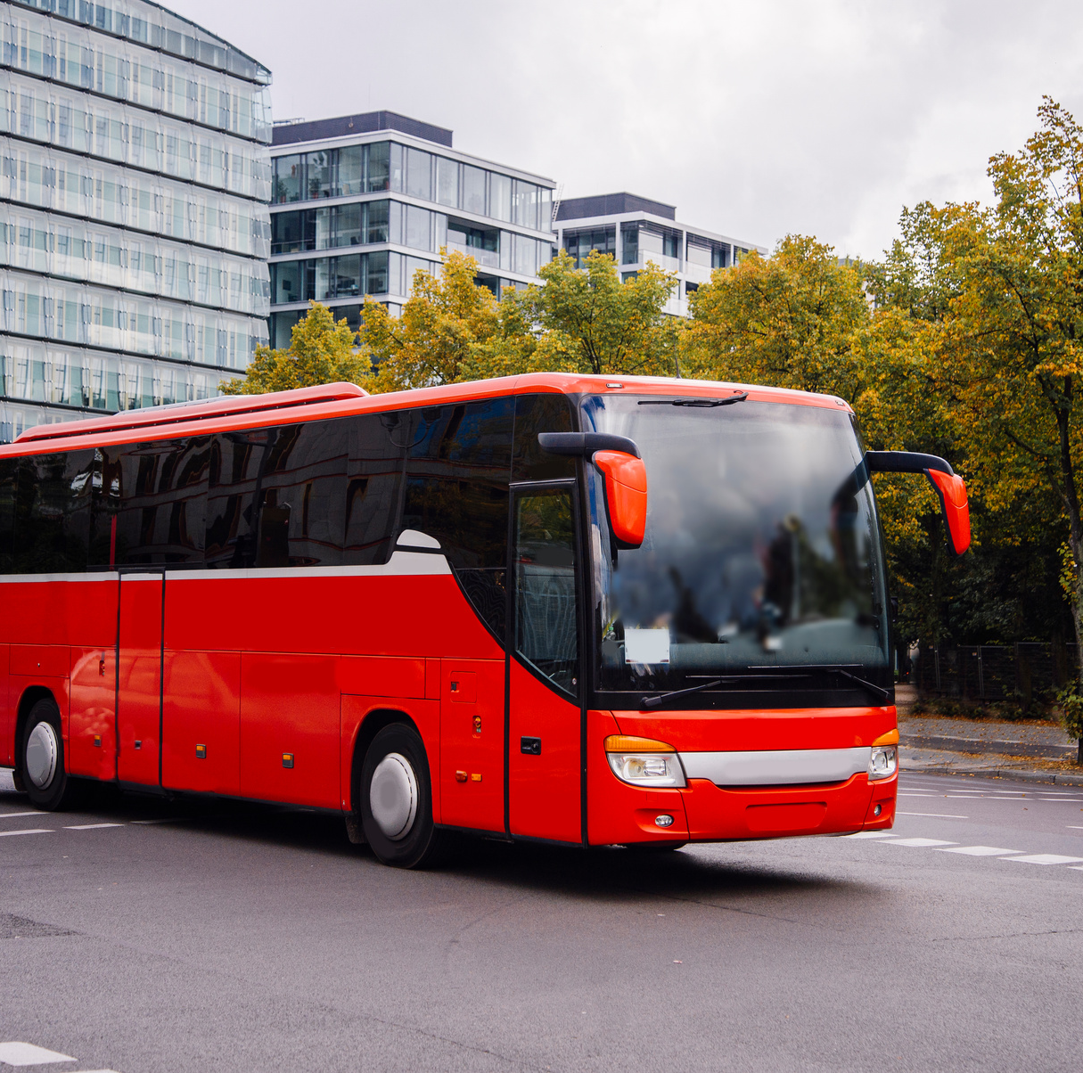
MOTORCOACH
EXPECTATIONS
05
  Carry-on bag only on the bus
  Water allowed on board
    NO food
    NO gum
  Remain seated while the bus is moving
  Keep the coach clean and respectful
Motorcoaches include restrooms, but regular stops will be scheduled to limit the need for use on board.

Slide 12

06
ELECTRONICS
SCHOOL POLICY FOR YOUR PROGRAM:
  What electronics are allowed?
  When can devices be used?
Electronics may be limited during parts of your program to encourage participation and maximize your experience.

Slide 13
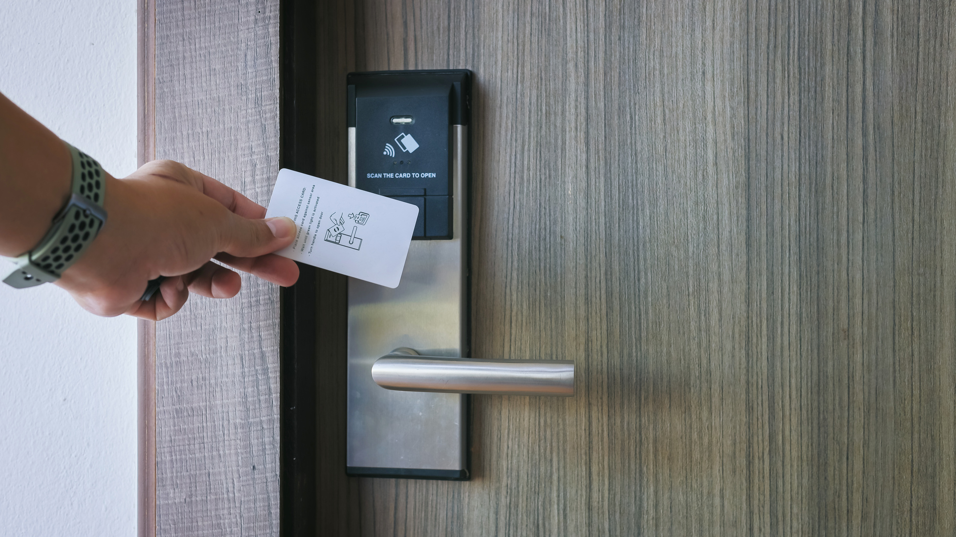
HOTEL EXPECTATIONS
07
GUIDELINES
  Students should be in rooms within
15 minutes of arrival
  Curfew and lights-out determined each evening
  Boys in boys’ room - girls in girls’ room
  Shoes required in hallways
  Students must travel in groups – never alone

Slide 14
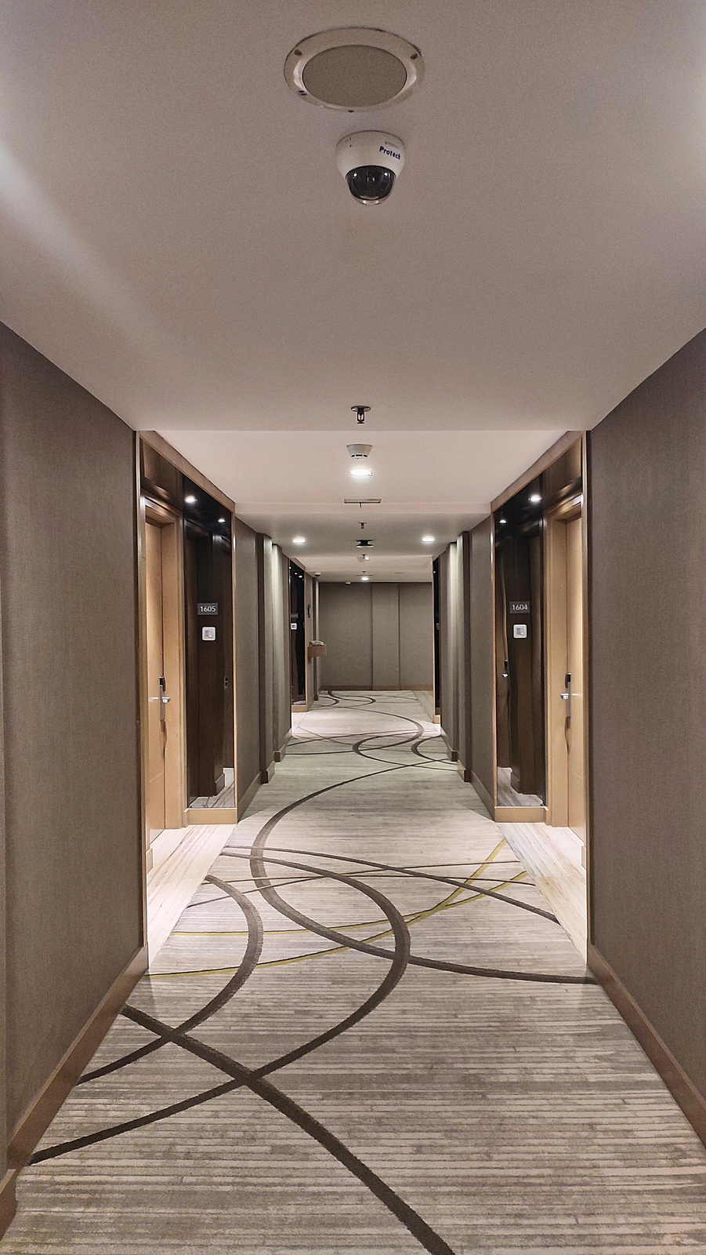
HOTEL SAFETY
  Chaperones conduct evening room checks
  Students should remain on assigned floors and may not leave the floor without an adult
  Rooms should be left clean at checkout
Security staff will be present on hotel floors overnight.
HOTEL CONDUCT
  To respect our hotel partners, students must remain quiet and orderly in hallways and shared spaces.

Slide 15
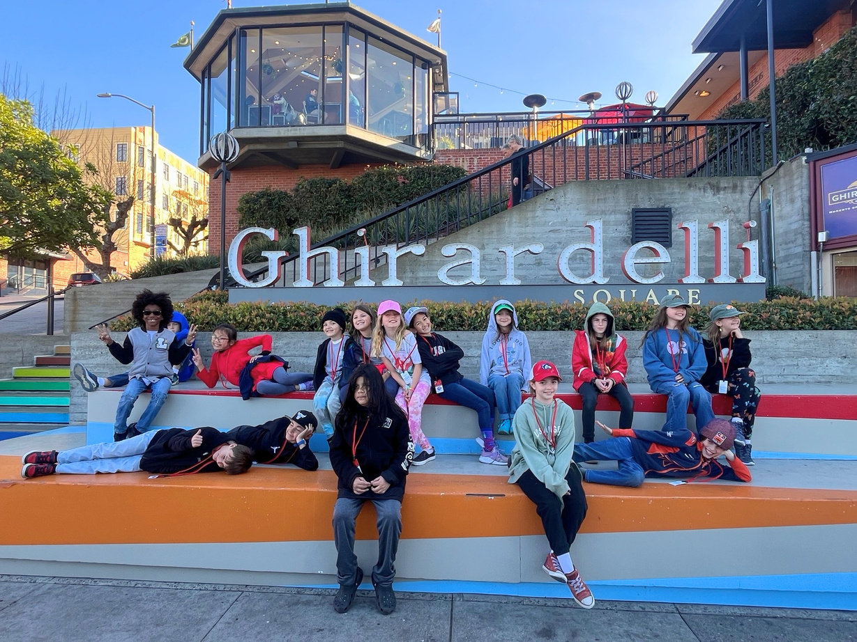
DAILY
EXPECTATIONS
08
Students represent their
school and community.
Please be:
  Respectful
  Courteous
  Attentive during tours and activities.
Students must remain with their
chaperone group at attractions.

Slide 16
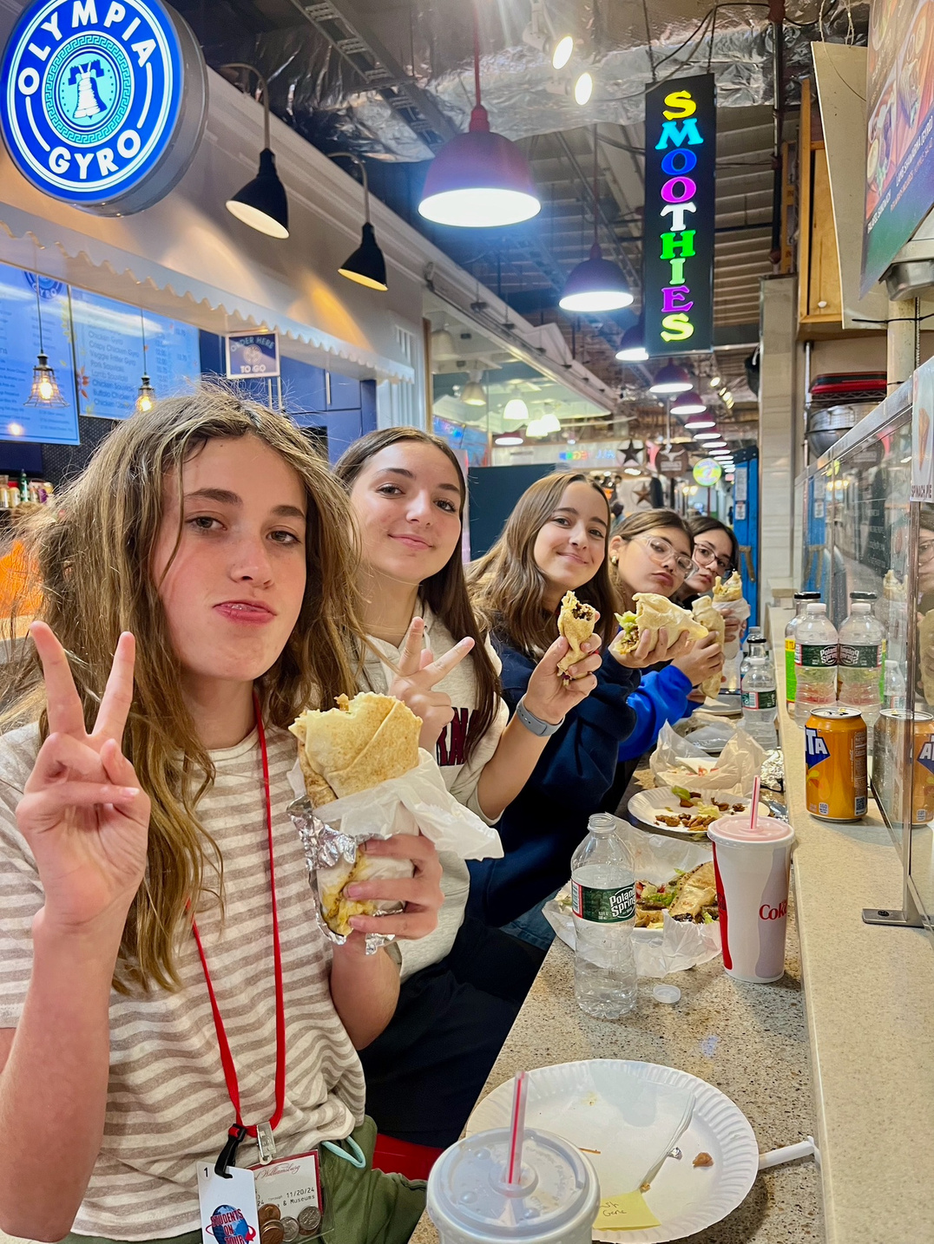
MONEY & SOUVENIRS
09
SPENDING MONEY
  Suggested amount:
$15-20 per day for lunches
Additional money may be brought for:
  Souvenirs
  Snacks
Not permitted souvenirs include:
inappropriate apparel, toy weapons, fireworks, or novelty prank items

Slide 17
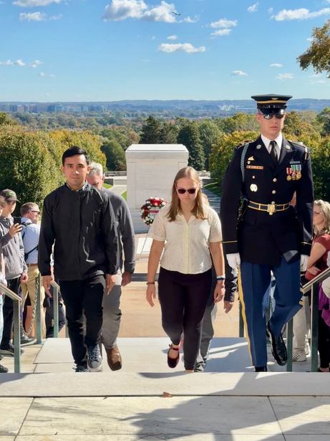
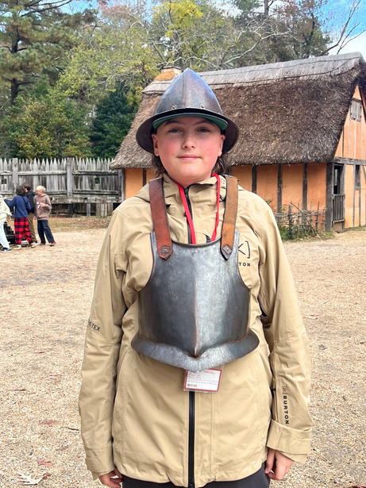
10
DRESS CODE
DRESS EXPECTATIONS
  School dress code may apply
  Comfortable clothing recommended
Special events may include:
  Arlington Wreath Ceremony guidelines
  Broadway attire determined by school

Slide 18
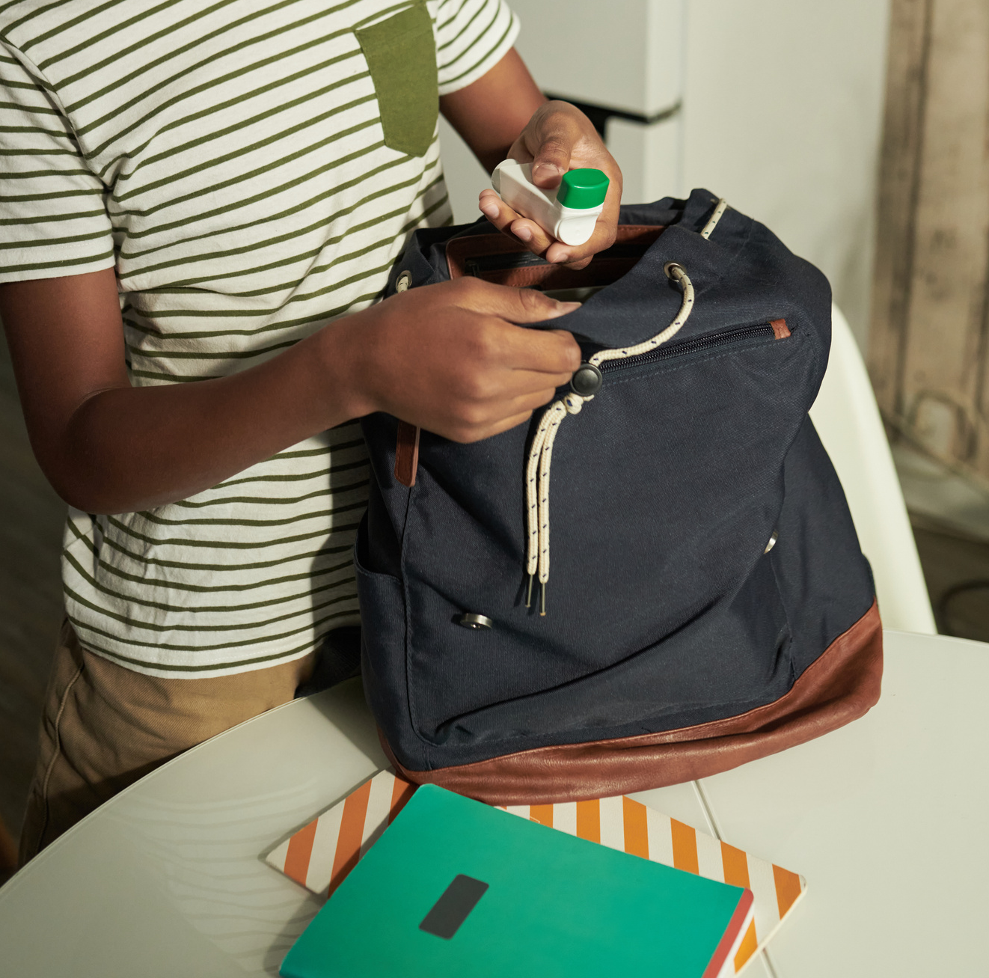
11
HEALTH & SAFETY
MEDICAL NEEDS
  Notify teachers of any medical conditions
  Follow school medication policy
  Inhaler must be prescribed to be admitted in government buildings
Students should always communicate with chaperones if they feel unwell.

Slide 19
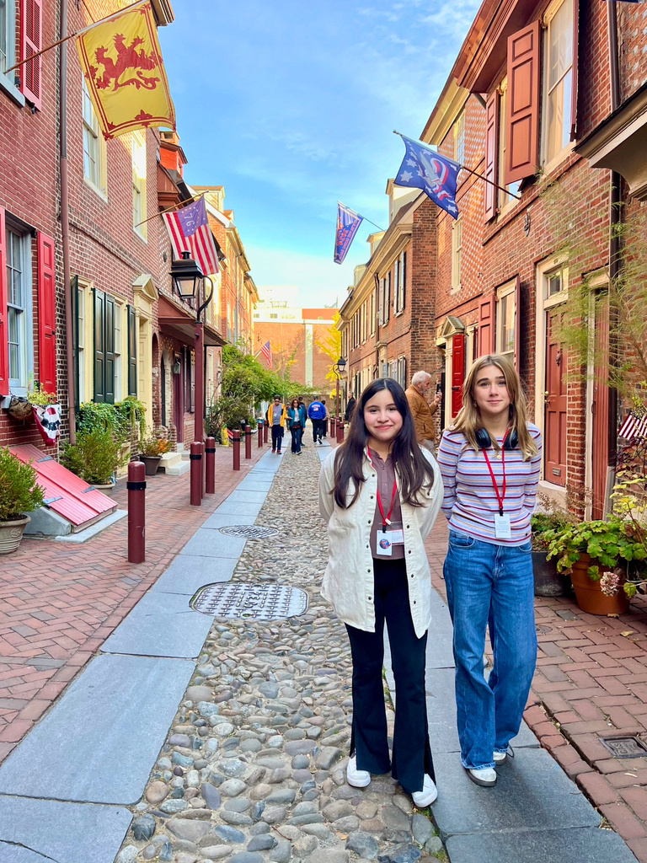
11
COMMUNICATION
EMERGENCY COMMUNICATION
Parents may contact:
  Teachers / chaperones
  SOT Emergency Hotline: 800-286-8732 (Option 2)
SOT ID Badges will be issued on departure day and should be worn daily.
Emergency SOT number is written on
each badge for easy access if needed.

Slide 20
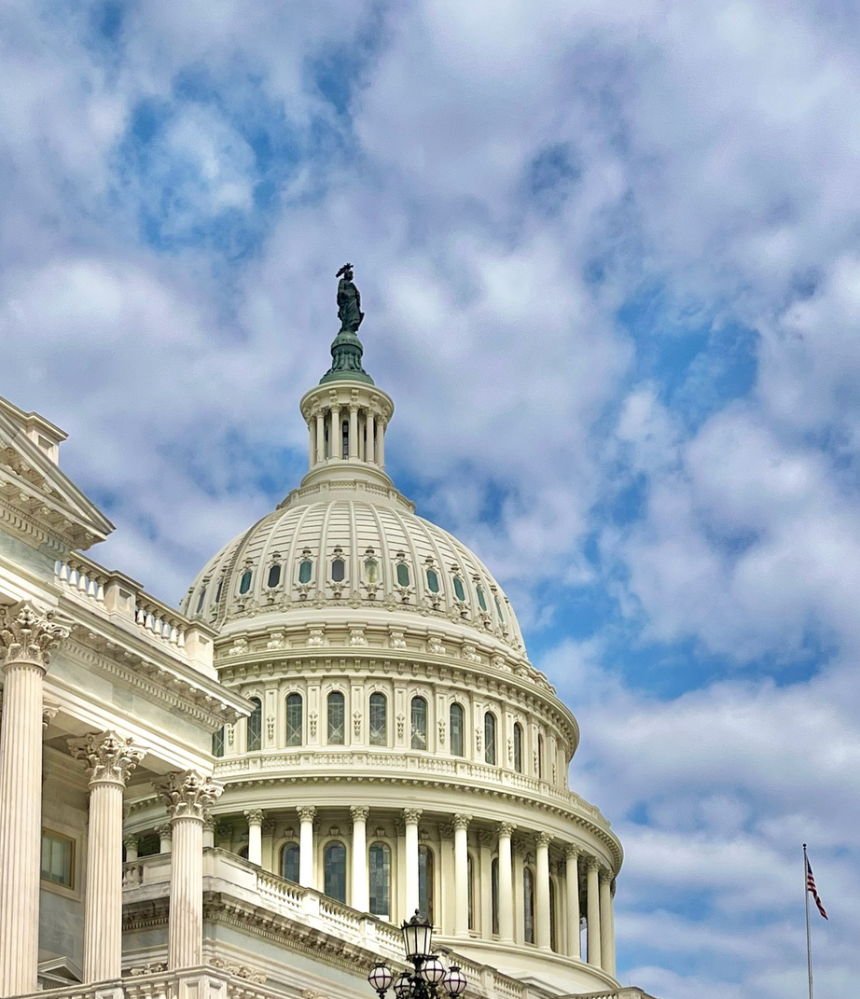
QUESTIONS?
We're excited to prepare for an incredible trip filled with learning, adventure, and unforgettable memories!

Slide 21
THANK YOU FOR JOINING AN
EDUCATION PROGRAM
WITH STUDENTS ON TOURS

